Slide 1
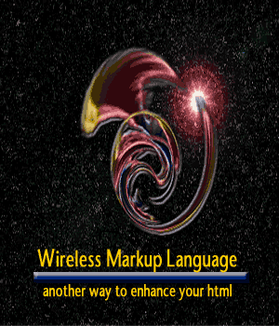
WML

Slide 2
Topics
Introduction
History
Security Issue
Design
Syntax
Examples
Requirements
Pro’s and Con’s
Limitations
Future

Slide 3
Introduction to WML
. Used to create document for WAP enabled device.
WAP (Wireless Application Protocol) allows you to write short programs for mobile phones and other small hand-held devices.
Similar to HTML and XML.

Slide 4
History of WML
In 1995, Ericcson developed a protocol that offered value added services to wireless networks and applications.
Several other companies soon followed.
The two major players were Nokia and Phone.com among the frenzy of other companies.
The WAP Forum was formed and release WML 1.0 in 1997.
A combination of:
  Phone.com's Handheld Device Markup Language (HDML).
  Ericcson's Intelligent Terminal Transfer Protocol (ITTP).
  Nokia's Tagged Text Markup Language (TTML)

Slide 5
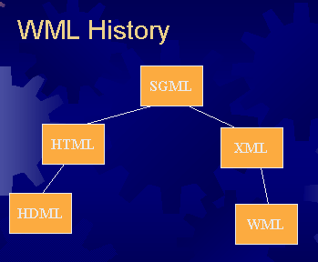
Evolution of WML
WML was preceded by HDML.
HDML borrowed heavily from HTML.
It then evolved into the XML-compliant application we know as WML.
WML has yet to penetrate the market in an established way.

Slide 6
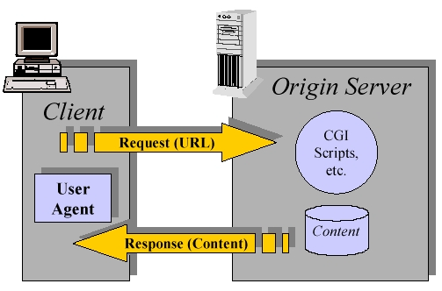
HTML via Internet

Slide 7
Security Issues
The four concerns that must be addressed:
Privacy: ensures that only the sender and the intended recipient can read the encrypted message.
Integrity: ensures the detection of any content changes of a message between the time it is sent and the time it is received.
Authentication: ensures that all parties in a communication are who they claim to be.
Non-repudiation: guarantee that a party cannot falsely claim that they did not participate in that transaction.
A combination of the Secure Socket Layer (SSL) protocol, digital certificates, username-password and digital signatures ensure the above.

Slide 8
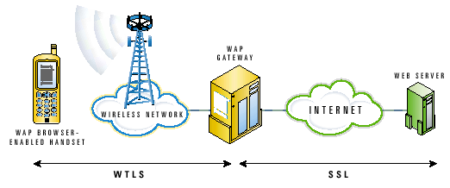
Security Issues (con't)

Slide 9
The Design of WML
Units of user interactions.
A deck-and-card metaphor.
Collects data within a deck-of cards.
Each card can:
  Display text images.
  Control input.
  Perform actions.
  And the cards are switch from one to another.

Slide 10
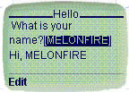
A Brief Example of Deck-of-Cards
“head” element and “meta” information about the document
<?xml version="1.0"?> <!DOCTYPE wml PUBLIC “-//WAPFORUM//DTD WML 1.1//EN”
"http://www.wapforum.org/DTD/wml_1.1.xml">
. A deck and a card which asks the user input and display it on the screen.
<wml> <!– a deck -- >
<card id="Hello" title="Hello">
<p> What is your name?
<input format="*M" name="name” title="Name"/>
<br/> Hi, $(name)
</p>
</card>
</wml>

Slide 11
Syntax of WML
<element attribute=“value”> content </element>
Case-sensitive
All tags are lowercase, must be closed and properly nested.
If an element has no data, a tag appended with a “/” character is need. Eg: <br/>
Comments can be <!-- comments -- >
The value must be quoted.
. A valid WML document must correspond to this DTD or it cannot be processed. http://www.wapforum.org/DTD/wml_1.1.xml
. Like JavaScript interact with HTML, WMLScript is used with WML to provide intelligence and advanced UI (User Interface) functions to the client.

Slide 12
WML ELEMENTS
Deck and Card elements
Wml: defines a deck and encloses all card information.
Card: contains text and elements in an individual card.
Event elements
∙ Do: mechanisms for performing actions within a card.
WML ATTRIBUTES
Ontimer: events occurs when a timer expires.
Onpick: occurs when user select or deselect option.
Ex: <card id = “card1” ontimer= “#card2” title=“WMLEx”>
  <timer value = “50”/> <! -- move from card1 to card2 in 5s-- >.
  WML tags
. Go: navigates to a URL.
. Prev: navigates to a previous URL.
. Ex: <go href="#Results"/> <! – go to a card or a servlet -- >
Ex: <go href=http://thu/servlet/login?f=$(name)#38/>
WML variables
. Setvar: Element used to set a variable.
Ex: <setvar name = “location” value=“$(X)” />
Ex: $(identifier) is used to display/call the variable

Slide 13
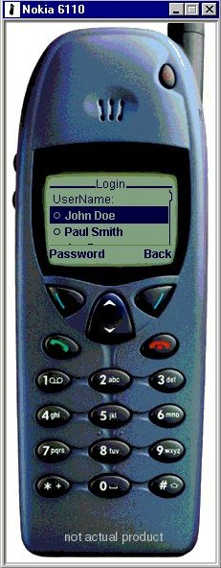
BUILDING A WML DOCUMENT
Listing 1 - WMLExample.wml
It is an error to omit the following lines:
<?xml version='1.0'?>
<!DOCTYPE wml PUBLIC "-//WAPFORUM//DTD WML 1.1//EN" "http://www.wapforum.org/DTD/wml_1.1.xml">
A deck and 3 cards: Login, Password, and Result
<wml>
<card id="Login" title="Login">
<do type="accept" label="Password">
<go href="#Password"/>
</do>
<p>UserName:
<select name="name" title="Name:">
<option value="John Doe">John Doe</option>
<option value="Paul Smith">Paul Smith</option>
</select>
</p>
</card>

Slide 14
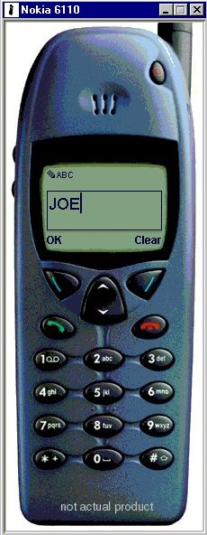
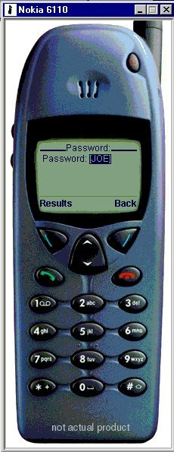
BUILDING A WML DOCUMENT (CON’T)
<card id="Password" title="Password:">
<do type="accept” label="Results">
<go href="#Results"/>
</do>
<p>Password: <input type="text" name="password"/>
</p>
</card>

Slide 15
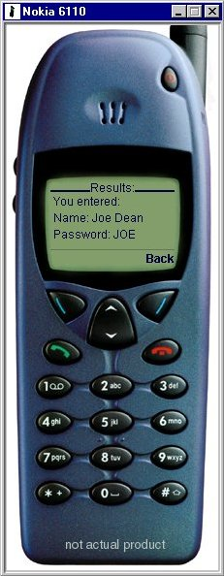
BUILDING A WML DOCUMENT(CON’T)
<card id="Results” title="Results:">
<p>
You entered:<br/>
Name: $(name)<br/>
Password: $(password)<br/>
</p>
</card>
</wml>
Figure 4

Slide 16
BUILDING A WML DOCUMENT(CON’T)
For running the WML document. You must register the proper MIME types with your Web server so that WML content can be properly sent. The two MIME types that should be registered are:
.wml text/vnd.wap.wml
.wmls text/vnd.wap.wmlscript
If you’d like to use Wireless Bitmap images (the image format supported by WAP), also add:
.wbmp image/vnd.wap.wbmp

Slide 17
REQUIREMENT
All you need is a WAP-Browser

Slide 18
PRO’S AND CON’S
Pro
- WML is a compressed “version” of HTML
- Optimized for long latency
- Optimized for low bandwidth
- Operate over a wide variety of wireless transports (cell phones PDA’s ….)
- Scalable from a two-line text display to a full graphic screen.
- Network standard independent
. Con
- Possible security breaches
- Limited size per card aprox 1400 bytes

Slide 19
LIMITATIONS
No card can be larger then 14000 bytes
Small screen size (cell phones)
Limited bandwidth- transferring data from phones is inherently slow
Unreliability- Wireless devices by nature are unreliable

Slide 20
FUTURE
WML will be replaced by another language (That’s Bad)
WML-coded pages will still be able to be displayed (That’s Good)
i.e. backwards compatible
Moving towards XHTML

